Slide 1

GLOBAL UNICORN COMPANIES DATA SET ANALYSIS

Slide 2
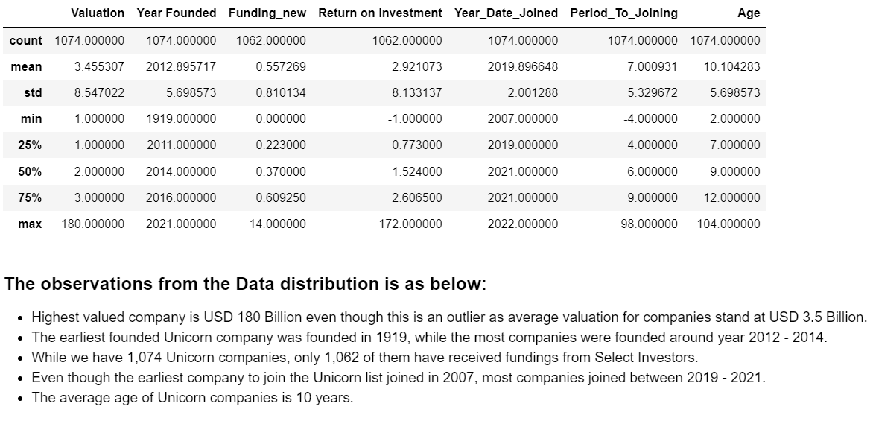
Unicorn Data Distribution

Slide 3
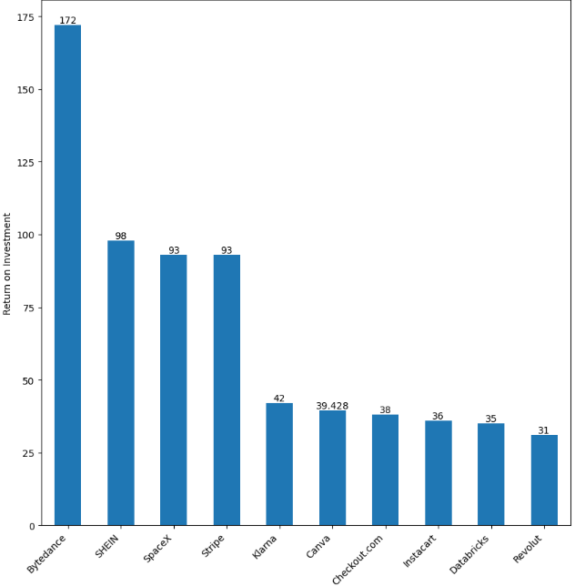
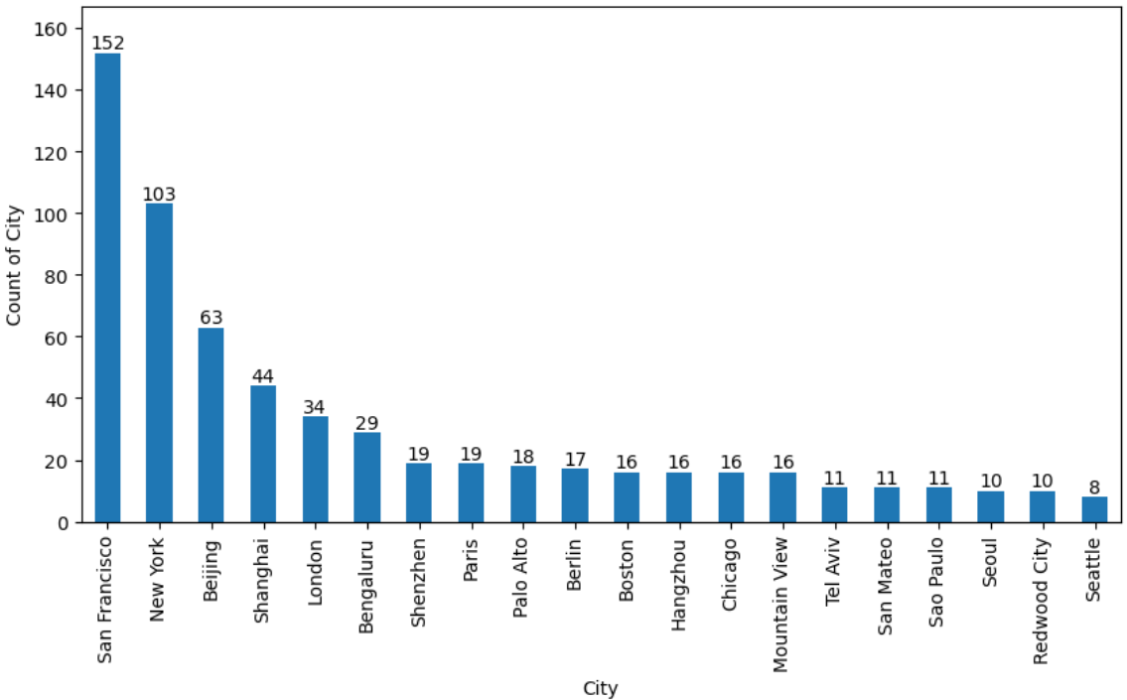
The top 10 companies with highest ROI are shown above with Bytedance- a company within the AI Industry in Beijing, China taking the lead. ROI is calculated by deducting Fundings received from Current Valuation of companies. Unicorn Industry Hub cities in the US are San Francisco, New York. While those in China and UK are Beijing, Shanghai, Shenzhen and London respectively. India also has a hub in Bengaluru.

Slide 4
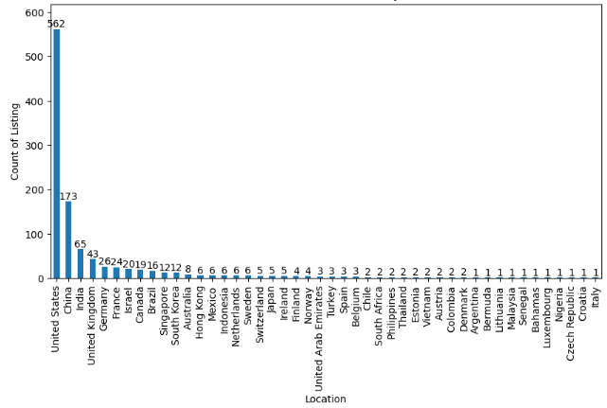
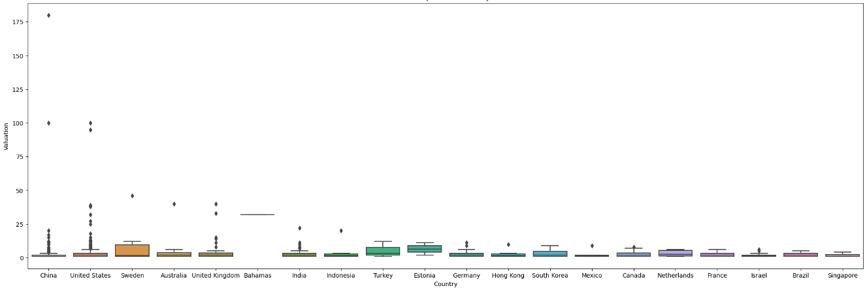
United States Has The Highest Number Of Unicorns By A Very Great Margin, Followed By China. It Should Be Noted That Us Has More Than 50% Unicorns On This List. Most Valued Unicorn Is In China, The Ai Company- Bytedance Identified Earlier. We Can See Here It's Valued At Usd 180 Billion. Asides This Outlier Value, The Bahamas Has The Average Most Valued Unicorn, Even Though This Is Misleading As It Is Just one company.

Slide 5
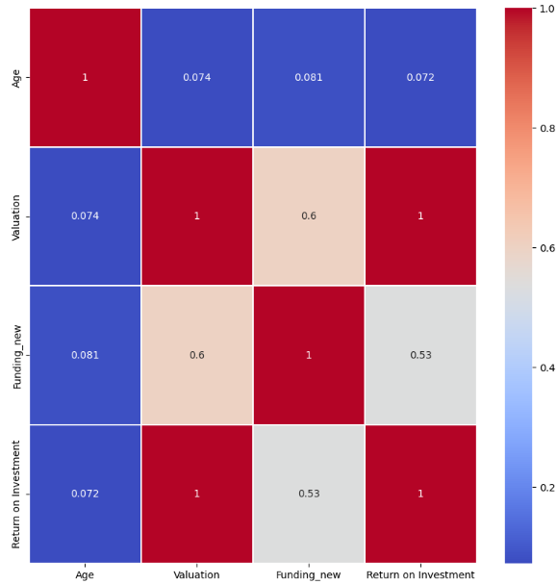
The Valuation of a company has a perfectly positive (strong) relationship with the Return on Investment of the company. Fundings received also showed a strong relationship with Return on Investment of Unicorns, as well as on the Valuation of the Unicorn.
Overall, we have been able to note the following information from our Data set:
USA has more Unicorns than most parts of the world, and as such get more fundings than most part of the world.
The most valued Unicorns are in China and United States.
AI remains the most profitable (based on Return on Investment) and most companies within this Industry gets Funding faster and attain the Unicorn status quicker.
It should be noted that receiving Funding is not a pre-requisite to attaining the Unicorn status. However, it has shown that it makes attaining the Unicorn status quicker.
Companies that intend to attain this status need to look at these qualities and attributes and follow those they can, to speed up their Unicorn attainment goal.

